Slide 1
Course Code: ICT-4103
Course Title: DigitaL ImaGe Processing
Book:
Digital image processing by Rafael C. Gonzalez and Richard E. Woods
Fundamentals of Digital Image Processing by S. Annadurai
Digital Image Processing: Whole world can be represented as data or information
“One picture is worth more than one thousand words”

Slide 2
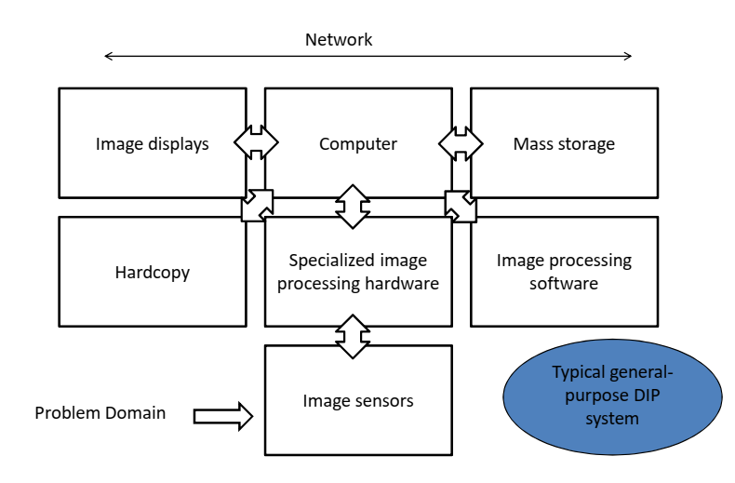
Components of an Image Processing Syatem

Slide 3
Components of an Image Processing Syatem
1. Image Sensors
Two elements are required to acquire digital images. The first is the physical device that is sensitive to the energy radiated by the object we wish to image (Sensor). The second, called a digitizer, is a device for converting the output of the physical sensing device into digital form.

Slide 4
Components of an Image Processing Syatem
2. Specialized Image Processing Hardware
Usually consists of the digitizer, mentioned before, plus hardware that performs other primitive operations, such as an arithmetic logic unit (ALU), which performs arithmetic and logical operations in parallel on entire images.
This type of hardware sometimes is called a frontend subsystem, and its most distinguishing characteristic is speed. In other words, this unit performs functions that require fast data throughputs that the typical main computer cannot handle.

Slide 5
Components of an Image Processing Syatem
3. Computer
The computer in an image processing system is a general-purpose computer and can range from a PC to a supercomputer. In dedicated applications, sometimes specially designed computers are used to achieve a required level of performance.

Slide 6
Components of an Image Processing Syatem
4. Image Processing Software
Software for image processing consists of specialized modules that perform specific tasks. A well-designed package also includes the capability for the user to write code that, as a minimum, utilizes the specialized modules.

Slide 7
Components of an Image Processing Syatem
5. Mass Storage Capability
Mass storage capability is a must in a image processing applications. And image of sized 1024 *1024 pixels requires one megabyte of storage space if the image is not compressed.
Digital storage for image processing applications falls into three principal categories:
1. Short-term storage for use during processing.
2. on line storage for relatively fast recall
3. Archival storage, characterized by infrequent access

Slide 8
Components of an Image Processing Syatem
5. Mass Storage Capability
One method of providing short-term storage is computer memory. Another is by specialized boards, called frame buffers, that store one or more images and can be accessed rapidly. The on-line storage method, allows virtually instantaneous image zoom, as well as scroll (vertical shifts) and pan (horizontal shifts). On-line storage generally takes the form of magnetic disks and optical-media storage. The key factor characterizing on-line storage is frequent access to the stored data.

Slide 9
Components of an Image Processing Syatem
6. Image Displays
The displays in use today are mainly color (preferably flat screen) TV monitors. Monitors are driven by the outputs of the image and graphics display cards that are an integral part of a computer system.

Slide 10
Components of an Image Processing Syatem
7. Hardcopy devices
Used for recording images, include laser printers, film cameras, heat-sensitive devices, inkjet units and digital units, such as optical and CD-Rom disks.

Slide 11
Components of an Image Processing Syatem
8. Networking
Is almost a default function in any computer system, in use today. Because of the large amount of data inherent in image processing applications the key consideration in image transmission is bandwidth.
In dedicated networks, this typically is not a problem, but communications with remote sites via the internet are not always as efficient.

Slide 12
Applications of Digital Image Processing
Digital image processing has a broad spectrum of applications such as:
-Remote sensing via satellites and other spacecrafts images
Images acquired by satellites are useful in tracking of earth resources, geographical mapping, prediction of agricultural crops, urban growth, and weather; flood and fire control and many other environmental applications.
Space image applications include recognition and analysis of objects contained in images obtained from deep space-probe missions.
-Image transmission and storage for business
Image transmission and storage applications occur in broadcast television, teleconferencing, transmission of facsimile images for office automation, communication over computer networks, CCTV based security monitoring system, and in military communications.

Slide 13
Applications of Digital Image Processing
-Medical images
In medical applications, X-ray images, CT, MRI, PET, Ultrasound and also other medical images are processed for diagnosis, monitoring and treatment for different kind of patient.
-Radar, sonar and acoustic images
Radar and sonar images are used for detection and recognition of various types of targets or in guidance and maneuvering of aircraft or missile systems.
-Robotics and automated inspection of industrial parts
From robot vision of industrial automation and image synthesis for cartoon making or fashion design.
In other words, whenever a human or a machine or any other entity receives data of two or more dimensions, an image is processed.

Slide 14
Elements of visual perception
Structure of the human eye
• The cornea and sclera outer cover
• The choroid
– Ciliary body
– Iris diaphragm
– Lens
• The retina
– Cones vision (photopic/bright-light vision):
centered at fovea, highly sensitive to color
– Rods (scotopic/dim-light vision): general view
– Blind spot

Slide 15
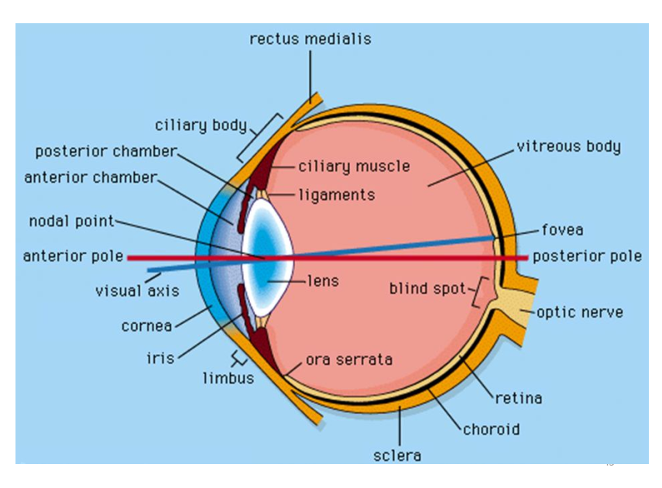
structure of the EYe

Slide 16
image formation in the eye
• Flexible lens
• Controlled by the tension in the fibers of the
ciliary body
– To focus on distant objects?
– To focus on objects near eye?
– Near-sighted and far-sighted

Slide 17
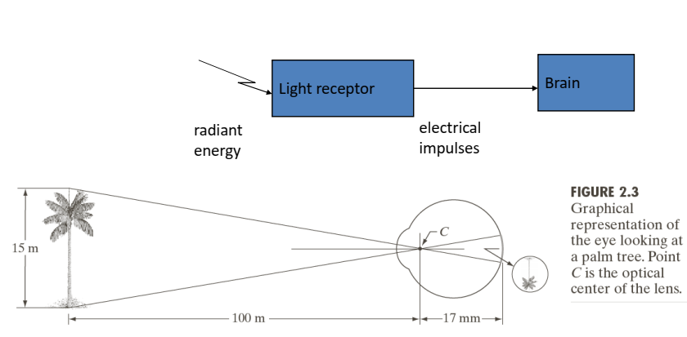
Image formation in the eye

Slide 18
image formation in the eye
In regular cameras, the lens has a fixed focal length, and focusing achieved by varying the distance between the lens and the imaging plane.
In human eye, however, the distance between the center of the lens and the retina is fixed (approximately 17mm), and the focal length is changed by varying the shape of the lens (14mm-17mm)

Slide 19
Image formation in the eye
Definition: monochromatic, chromatic, luminance, brightness
Monochromatic light is a light that is void of colour
Chromatic light spans the electromagnetic energy spectrum from 0.43 to 0.79 micro-meter.
Radiance is the total amount of enery that flows from the light source.
Luminance is the amount of energy that an observer perceives from a light source.
Brightness is a subjective descriptor of light perception that is impossible to measure.

Slide 20
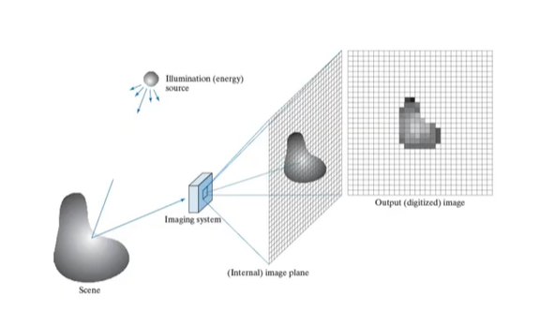
Image formation model

Slide 21
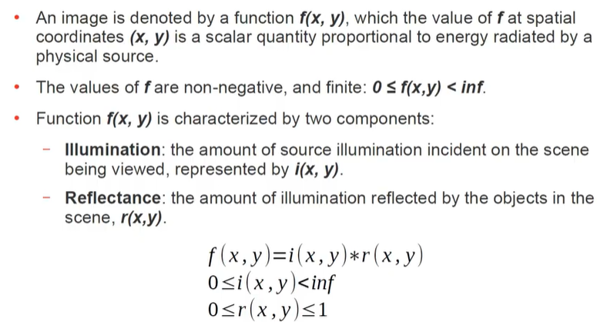
IMAGE formation model

